Slide 1
SEO and Lead Generation
Seattle Give Camp
October 2012
Richard Geasey

Slide 2


Slide 3
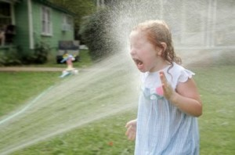

Slide 4
What’s the Deal
Every business, profit or otherwise needs leads
For non profits
Donations
User services
Volunteers
Outreach
So how do you get there with your web site
Traffic (SEO and Paid advertising)
Conversion

Slide 5
Search Engine Optimization
The never ending practice of attracting visitors to your web site
On page
Off page
Objective of a page one listing on Google (and other search engines)
Local ranking is much easier than national ranking
Especially with local modifier included (a city or locale name)
Be sure to include Google+ (local) in your efforts

Slide 6
Conversion
Once a visitor arrives, what happens next
Design of page guides visitor to the call to action
Must be clear
Develop “sales funnel”
Can’t go for the full close right away
Know what you want for and from a visitor
Assistance
Donations
Volunteer
Information

Slide 7
The Formula
Traffic x Conversion= Site Success

Slide 8
How Do You Stack Up Today
Do a search for your primary keywords
Not on page 1, you are essentially invisible
Use tools like
www.websitegrader.com
www.woorank.com
Do you show up in Google+
Claim your listing

Slide 9
Keywords
Internet search is ALL about keywords
What are yours
You probably rank for your organization name
If too broad you will have difficulty ranking
Time and money cures this
Niche is where you win
Less competition
Ensure it matches your mission and services
Know what you want to rank for
This is the first step

Slide 10
On Page SEO
The starting point
Gives you a lot of bang for your time and money
Actions you perform on your site
SEO is a page by page process, not just home page
Every page should have a keyword focus
On page elements are tags and content driven
Technical expertise requirement is minimal
Most On Page elements entered through the web site development tool (WordPress, Dreamweaver, etc.)
Steal (ooops, research) your top ranking competitors tags by viewing source code

Slide 11
Elements of On Page SEO
Site meta tags
Title
Description
Keyword
Image
Content
Keyword density on the page
Use of Heading tags (H1 and so forth)
Links with anchor text
URL of the page

Slide 12
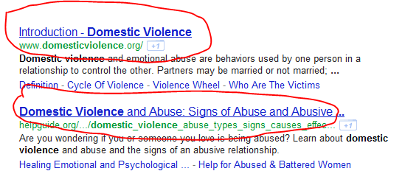
Title Tag
One of the most impactful elements to implement
In most sites it defaults to Page Name | Blog Name
Some new changes to this at Google
60 characters
Keywords!
Avoid throw away words

Slide 13
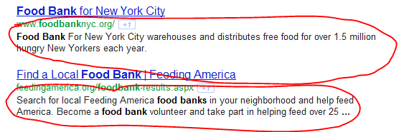
Description Tag
Not so important for SEO
Great as a reason to click on the link
160 character “elevator” pitch
Use keywords
Add contact information like phone number

Slide 14
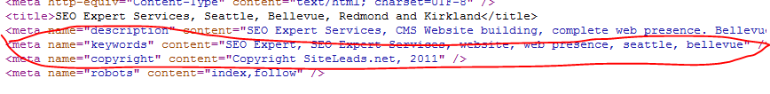
Keyword Tag
Not so important for SEO
Some search engines still use them
Good way to keep track of what you are focusing on for the page
Seven to ten keywords/keyword phrases
Separated by commas

Slide 15
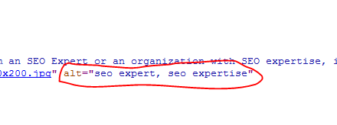
Image Tags
Also called Alt tags
Associated with all images
Use keywords (of course)
Also provides a text description of the image while loading
As an added bonus be sure to name your files with keywords
Keyword.jpg, not image123.jpg
You may be found in an image search too

Slide 16

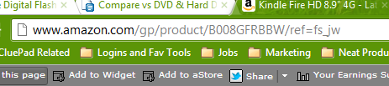
URL
Most production tools generate goobldy gook for a URL
If the tool allows it have it set for real words in your URL
Then use keywords for the URL

Slide 17
Content
Look for about 3% to 4% keyword density in content
Also use related phrases (look in Google searches)
Shoot for 400 words or better
Use H1, H2 and H3 heading tags
Create links to other relevant pages with anchor text
Regular content additions are important for long term success
Daily is ideal
It does not always have to be a full “article”, a few comments and refer to another article elsewhere
You can do a batch and stage the posting, same time every day
No separate blogs, integrate on your main site

Slide 18
Backlinking
The long term key to ranking success….. And staying there
Get links from high authority sites in your segment
Use anchor text (no Click Here)
Page Rank 5 and above are gold
Get links from government organizations (.GOV sites)
High authority sites in Google’s eyes
Easy for a non-profit obtain
From sponsors
Stay away from link farms
Google “Panda” update

Slide 19
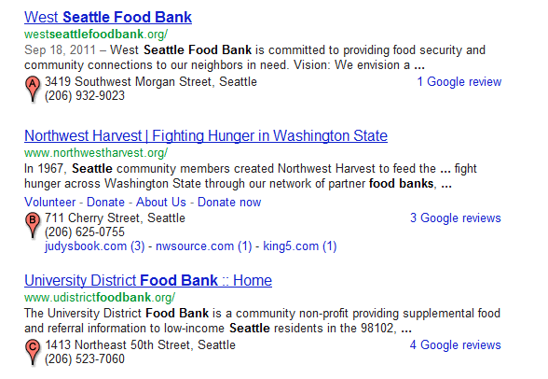
Google+ Places (formerly maps)
Not required but offers a great companion for your optimized site listing
Not every non-profit type listing will have Places display

Slide 20
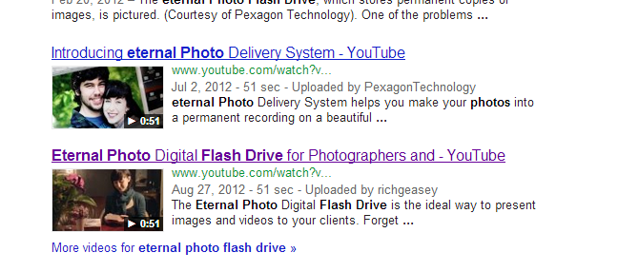
Video
Video is a powerful ancillary tool to your SEO efforts
Pinterest works well too
YouTube is the second most popular search engine
A video can easily show up for search results along with your site pages

Slide 21
Video
Best Practices
60 to 90 seconds
Stay on message
Contact information
Call to Action
Optimize the video
Keywords!
Captions
Annotations

Slide 22
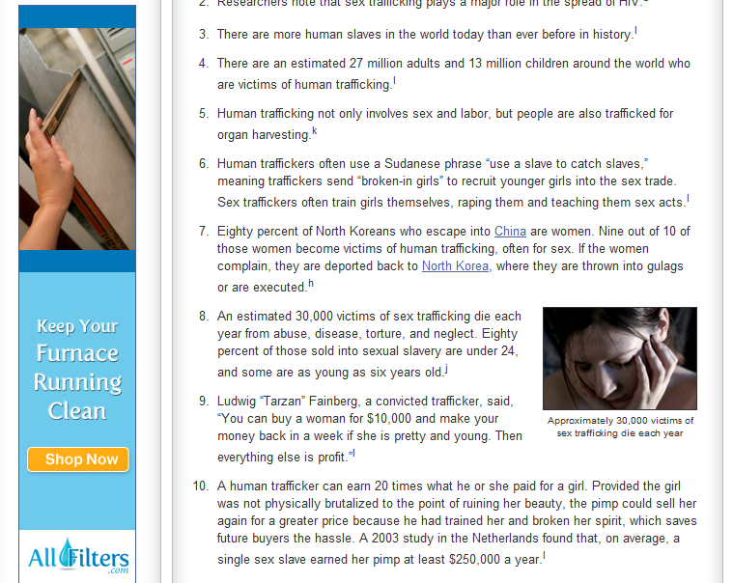
Paid Advertising
If your keywords are not being searched
Powerful way to generate traffic at the flip of a switch
Costs money (that’s why it’s called Pay per Click)
Need to have expertise here, don’t wing it
Remember the Google display network via AdSense
Directed placement of text and/or image ads

Slide 23
Conversion
Once a visitor arrives, what happens
You are likely looking for a donation or volunteer recruitment
Have < 10 seconds to grab attention
Create emotion
Have a powerful USP
Words sell, images support
Spend money on high impact copywriting
Ensure main messages are above the fold

Slide 24
Conversion Issues
Lack of clear message of what you do
Wishy washy words with no impact
Confusing placement of call to action
Make it clear WHAT you want the visitor to do
Can’t find contact info
Phone number five times on page
On every page you create
Asking for the order immediately
Asking for too much information

Slide 25
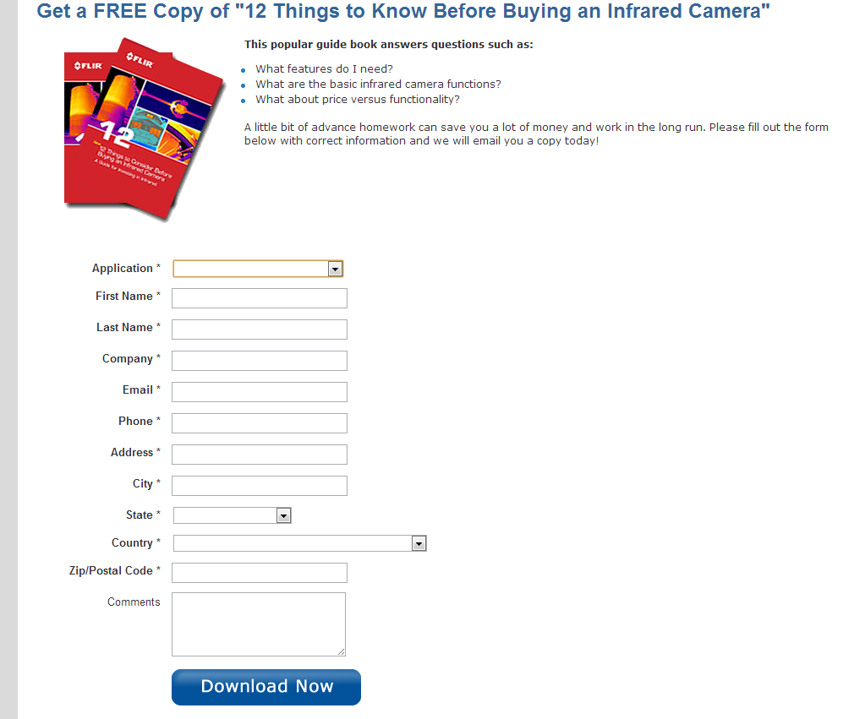
Asking Too Much?

Slide 26
The Sales Funnel
The majority of visitors won’t do anything
5% conversion is great in many situations
Must offer a way to get them in the process
The Sales Funnel
Offer something to capture their email address
Newsletter (better send them)
Case study
How to guide
Watch TV ads for examples
Use the mailing list to provide high quality content
Don’t hard sell, provide opportunities to “buy” in a soft way
Prove your cause is good and active and they should be a part of it

Slide 27
Mobile
A broad demographic group only has Internet access via their phone
Is your service time sensitive
Immediate and crisis need
Look at your site on a mobile phone
Can you read it
Can action be taken
Have a mobile only landing page
Key actions easy to see and respond to
Click to call
Short forms

Slide 28
WordPress SEO Plugins
All in One SEO
MOW All in One SEO Add on
Clickbump!

Slide 29
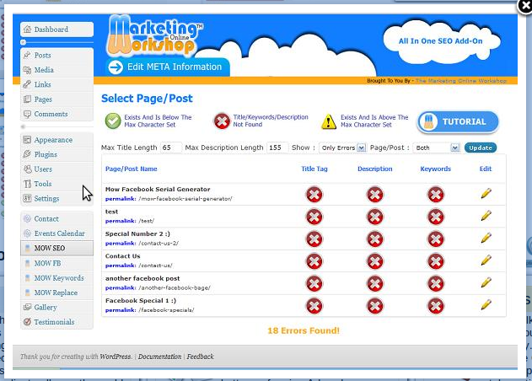
MOW

Slide 30
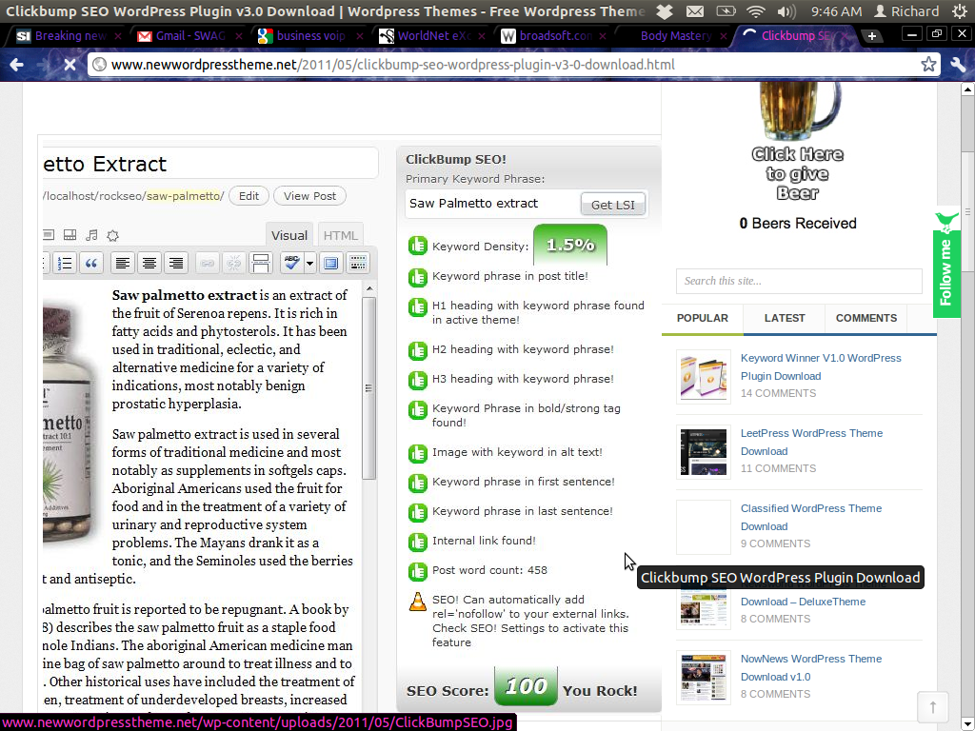
ClickBump

Slide 31
Wrapping Up
SEO works, but it takes time and effort
No silver bullets
A lot of little things all happening on a consistent basis
Look at conversion rates and opportunities for improvement
It’s often the most impactful thing you can do
Getting started
Take care of On Page stuff first, it’s the low hanging fruit
Begin content writing and backlinking
Evaluate and improve conversion process
Use analytics

Slide 32


